Slide 1


EchoSight Sentinel
Next-Gen AI-Powered Multi-Sensor Emergency Response
Zero Latency. Maximum Security.
Presented by: Peter Iyanuoluwa Quadri
January 5, 2026

Slide 2











The Blind Spots in Modern Security
Passive Recording
Motion Logic
Standard cameras merely record events for later review, offering no real-time intervention or proactive threat mitigation. They act as historical archives rather than active deterrents.
Traditional motion sensors are plagued by high false positive rates. Systems like ShotSpotter generate unconfirmed alerts between 80% and 92% of the time, triggered by benign events.
Acoustic Neglect
Manual Overhead
Most security setups overlook crucial auditory cues. Critical sounds like gunshots or screams are often ignored until it is too late, missing vital early warning signs of danger.
Homeowners are overwhelmed by a constant barrage of notifications, many of which are false alarms. This "notification fatigue" causes users to disregard alerts, increasing risk.
80-92% False Positive Rate
8-20% True Positives

Slide 3















Introducing EchoSight Sentinel
A dual-intelligence system that uses Acoustical Awareness to listen and AI Vision to verify, providing a proactive approach to security.
Acoustical Awareness
AI Vision
Listens for critical sounds in real-time with zero-latency response.
Analyzes visual data to verify threats and provide context.
Real-Time Sound Identification
Instant Visual Verification
Intelligent WhatsApp Alerts
Detects critical sounds like glass breaking, gunshots, and screams instantly.
Analyzes the exact moment of danger through AI vision.
Delivers human-descriptive notifications directly to your phone.

Slide 4







Response Time is Everything
In emergency situations, every second counts. EchoSight Sentinel redefines emergency response with a zero-latency approach.
Traditional Systems
EchoSight Sentinel
Significant delays in detection and response
Zero-latency detection and response
High false positive rates (80-92%)
Intelligent verification to eliminate false positives
Reactive rather than proactive security
Proactive security that shifts from detection to prevention
Key Takeaway: EchoSight Sentinel's zero-latency approach transforms emergency response from reactive to proactive, ensuring critical threats are addressed immediately.

Slide 5
























Deep Learning Audio Classification
Custom CNN Architecture
The CNN is specifically designed and trained on Mel-spectrogram signatures, excelling at identifying distinct acoustic patterns.
Audio Classification Process
Sound Capture
Audio input from sensitive microphones
Dynamic Energy Thresholding
Silence and irrelevant background noise are filtered out at the hardware level, reducing computational load.
Pre-processing
Dynamic energy thresholding
Temporal Voting
Feature Extraction
Mel-spectrogram conversion
Analyzing audio events within a sliding window and requiring a majority vote eliminates impulsive, non-threatening noises.
Classification
CNN analysis with temporal voting
Refined Dataset
The models are trained on a meticulously curated dataset, specifically engineered to distinguish between actual gunshots and common background "pops".
Alert System
WhatsApp notification if threat detected

Slide 6



















Past-Present AI Verification
Rolling 2-Second Video Buffer
Frame 2
Frame 3
Frame 4
Frame 5
Frame 6
Frame 7
Frame 8
Frame 9
Frame 10
Frame 11
Rolling 2-Second Buffer
Llama 4 Scout Integration
The system continuously captures and stores a 2-second video buffer in memory, ensuring access to critical moments before and during an event.
Utilizing the advanced Llama 4 Scout multimodal AI to perform deep analysis of a 10-frame burst from the buffered video.
Contextual Reasoning
False Positive Silencing
The AI provides human-descriptive summaries like "Person brandishing a tool" rather than raw data, offering actionable intelligence.
Intelligently suppresses alerts for false positives (e.g., child with toy gun), preventing notification fatigue and ensuring critical warnings.

Slide 7
















WhatsApp Integration & Remote Query
WhatsApp Notifier
Receive rich-text alerts directly to your smartphone, complete with AI-generated reasoning and event snapshots for immediate context.
EchoSight Sentinel
Real-time alerts & status updates
ALERT: Person detected at front door, brandishing a tool.
Remote Status Query
See image for verification.
Stay informed on demand. Send a "status" message to EchoSight Sentinel via WhatsApp to trigger a live visual report at your fingertips.
STATUS: All clear. Last activity: Mail delivery at 10:30 AM.
Link to live feed: [link]
Secure Tunnelling
Secure Connection
All communications secured using high-security Flask and ngrok architecture, ensuring your data and privacy are protected.
Twilio
Flask
ngrok

Slide 8


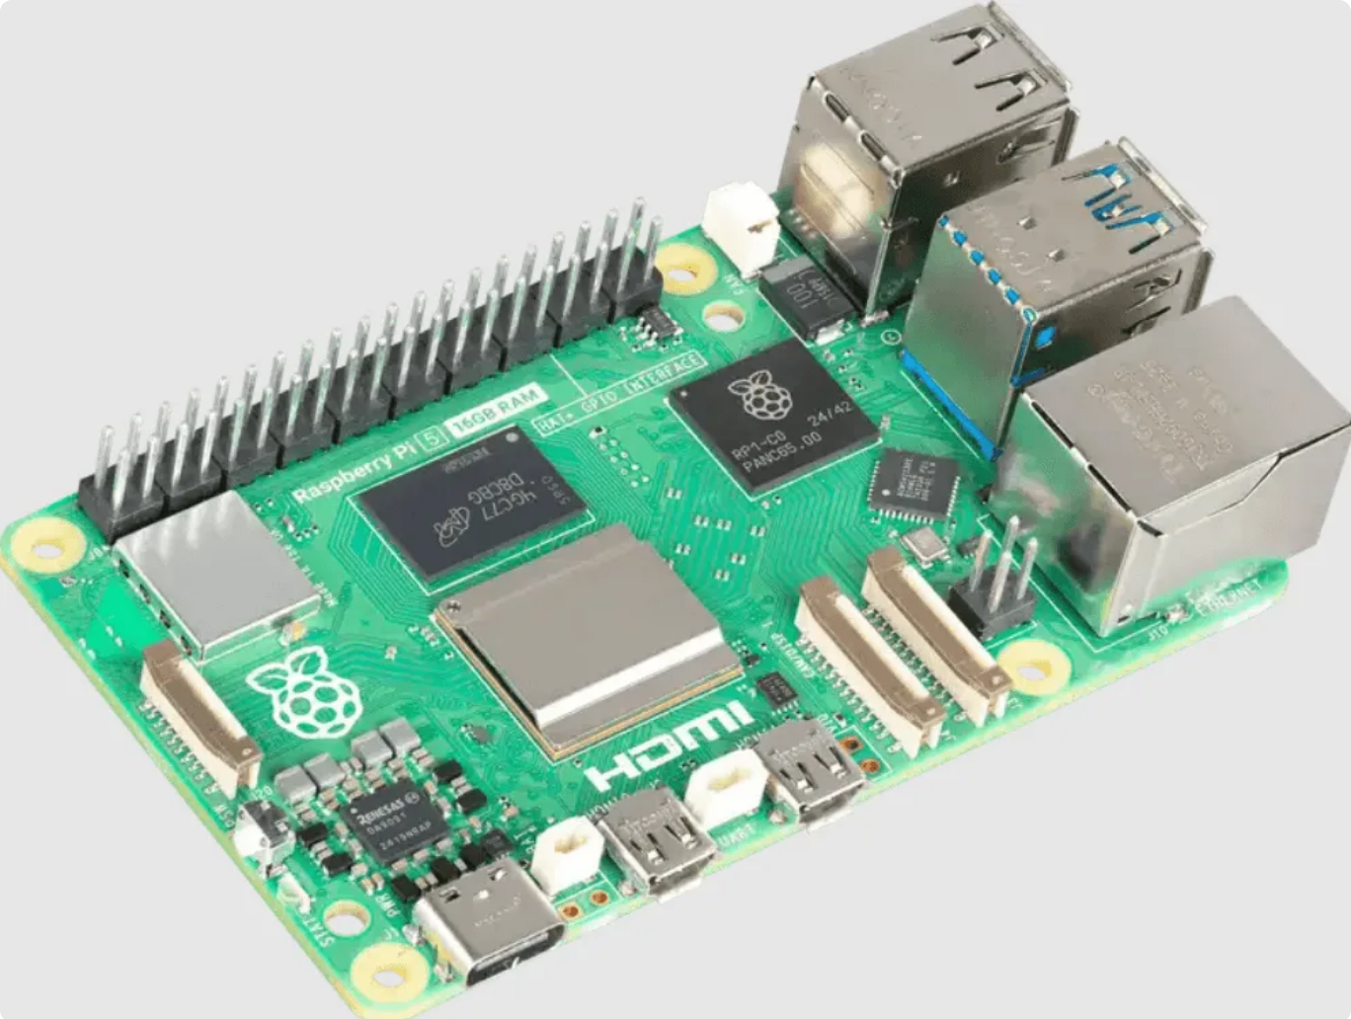

















Beyond the Prototype
Edge Computing
Optimized for high-performance, low-power devices, ensuring rapid, on-site processing. Ready for deployment on platforms like Raspberry Pi 5 & NVIDIA Jetson.
Raspberry Pi 5
NVIDIA Jetson
System Service
Designed for seamless integration and continuous operation. "Plug and Play" always-on functionality for effortless setup and maintenance.
Always-on Operation
Zero Configuration
Real-World Ready
EchoSight Sentinel is engineered for robust, real-world application, moving beyond conceptual design to deliver tangible security solutions.
Privacy First
Prioritizing user data security and privacy by design. Frame buffers are stored exclusively in-memory, never written to disk, until verified.
In-Memory Storage Only
No Disk Storage

Slide 9











Securing the Future
Passive Recording
Intelligent Response
Record & Replay
Detect & Act
EchoSight Sentinel doesn't just record; it understands and responds.
Transforming security from reactive to proactive.
Multi-Room Scaling
Mobile Integration
Expanding coverage to entire buildings with satellite nodes for comprehensive security.
Dedicated app for on-the-go monitoring and control.
Thank you
peterquadri19@gmail..com
Peter Iyanuoluwa Quadri

